Slide 1
CSE 4100/5100 - Operating Systems Spring 2026
Lecture - I Introduction
Dr. Zulkar Nine
Tennessee Tech University

Slide 2
What is an Operating System?
It is a program
It is a big hairy program
The Linux source code has more than 1.7 M lines of C code
A program that manages the computer hardware
An intermediary between the computer user and the computer hardware
Manages hardware and software resources of a computer

Slide 3
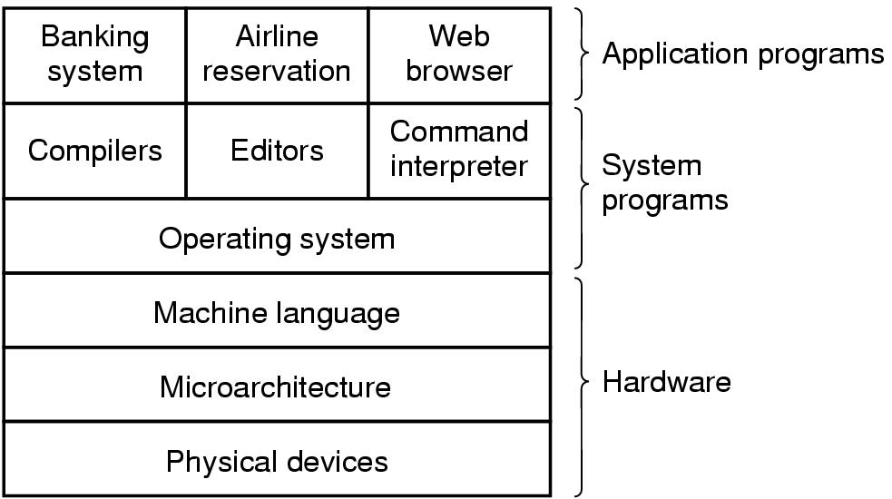
Role of an Operating System
The Tanenbaum “layered” view
Tanenbaum, A. S. (2001)
Modern Operating Systems (2nd Edition).
A computer system consists of hardware,
system programs and application programs
Notes:
HW: CPU, memory, disk, I/O devices

Slide 4
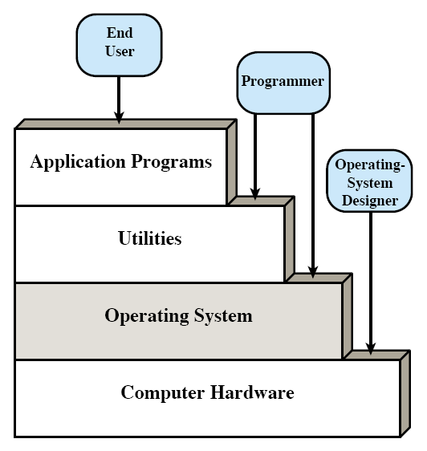
Role of an Operating System
The Stallings “layered & stairs” view
“Layers and stairs” view of a computer system
Notes:
HW: CPU, memory, disk, I/O devices

Slide 5
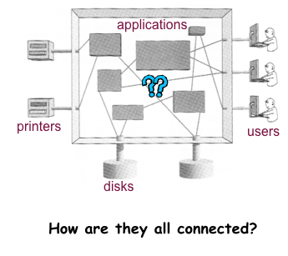
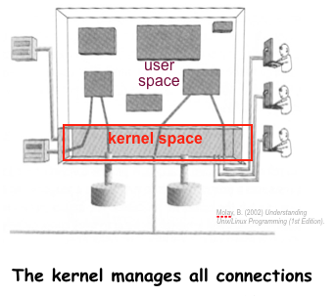
Role of an Operating System
The Molay “aquarium” view
the only not-layered view
everything must transit through the O/S or “kernel”

Slide 6
Key Point
An operating system is a program that acts as an intermediary between users/applications and the computer hardware.

Slide 7
Operating System Goals
From the user perspective:
Executes user programs and make solving user problems easier
Makes the computer system convenient to use
hides the messy details which must be performed
presents user with a virtual machine easier to use
From the System/HW Perspective:
Manages the resources
Uses the computer hardware in an efficient manner
time sharing: each program gets some time to use a resource
resource sharing: each program gets a portion of a resource

Slide 8
Virtualization!

Slide 9
What Expect to Learn?
Key Concepts of Operating Systems
Design, Implementation, and Optimization
Topics will include:
Processes, Threads and Concurrency
CPU and I/O Scheduling
Memory and Storage Management
File System Structures
Synchronization and Deadlocks
Protection and Security
Distributed Computing & Related Issues

Slide 10
Contact Information
Instructor: Dr. Zulkar Nine
Office: 428 Bruner Hall
Email:mnine@tntech.edu
Office hours: Tuesday/Thursday 12 Noon – 1 PM
Teaching Assistants:
Bradley Northan (banorthern42@tntech.edu)

Slide 11
Course Syllabus
Available at iLearns

Slide 12

Textbook: Required Highly Recommended

Slide 13
Recommended Supplementary Text

Slide 14
Work load
Group Projects – 2
Quizzes – 4~5
Midterm - 2
Attendance

Slide 15
Grade Components
The end-of-semester grades will be composed of:
Attendance/ Class work – 10%
Quizzes – 20%
Project – 20%
Midterm – 25%
Final exam – 25%

Slide 16
Projects
There will be two hands-on programming projects throughout the course.
These projects will aim to implement some core Operating System components at the kernel-level for better understanding of the concepts.
These will be “team” projects and they will require strong programming background (in C) and UNIX programming experience.
Teams will consist of four students.

Slide 17
Projects (cont.)
Both projects will be based on Pintos operating system.
Pintos is a simple operating system framework for the 80x86 architecture developed at Stanford University.
Link for Pintos guide

Slide 18
Pintos Projects
1. Threads <-- Project 1
2. User Programs

Slide 19
Pintos after full implementation (post prj-4)

Slide 20
Yo will be provided with this (pre prj-1)

Slide 21
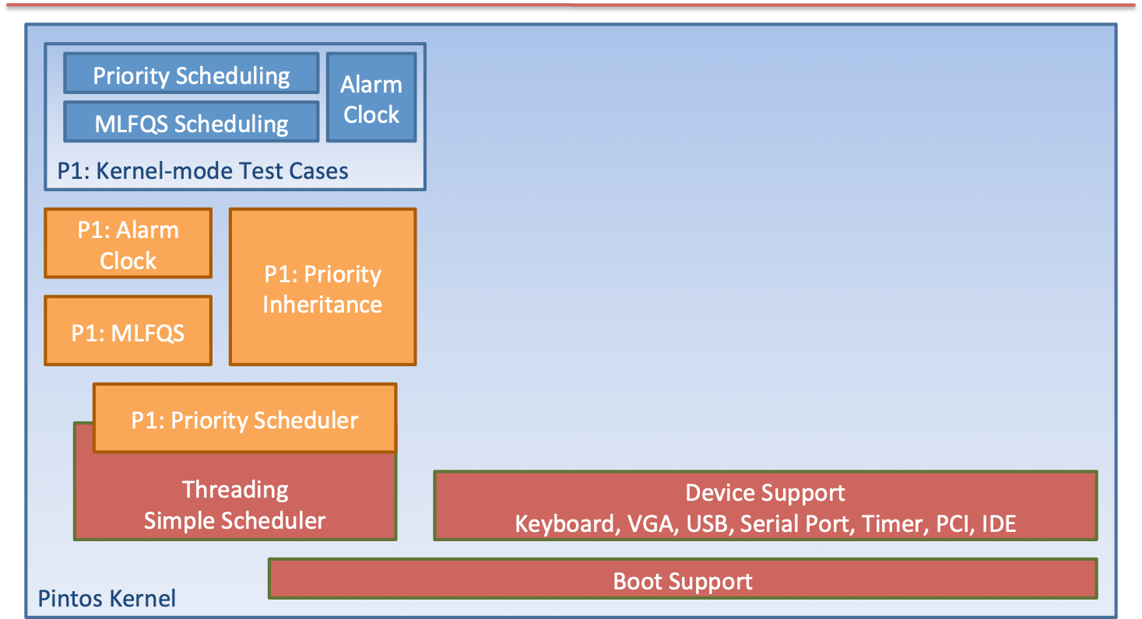
You will implement this (post prj-1)

Slide 22
Step 1: Preparation
READ:
Lecture slides on Processes, Threads and CPU Scheduling
[+ Corresponding chapters from Silberschatz]
From Pintos Documentation:
Section 1 - Introduction
Section 2 - Threads
Appendix A1- Pintos Loading
Appendix A2 - Threads
Appendix A3 - Synchronization
Appendix B - 4.4BSD Scheduler

Slide 23
Ways to Fail
Don’t attend classes
Don’t go to office hours
Start your project at the last minute
Cheat!

Slide 24
Academic Integrity
Rule is simple.
Please do not copy other works.
Both will receive the same penalty.
First time – it will be a zero in particular component
Second time – an automatic F grade on the course.

Slide 25
Academic Integrity
Cheating is submitting any work you did not perform by yourself as you did.

Slide 26
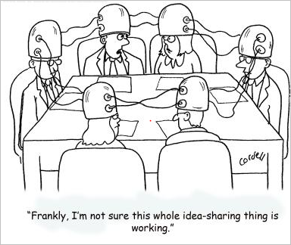
Group Study
is fine
However, submit your own work
You can share idea, but not the
code.

Slide 27
What is OK, and what is not OK?
References (when cited)
wikipedia, wikibooks etc.
—> OK (except source code)
wikipedia, wikibooks etc.
Public Code
GitHub, stack exchange etc.
—> Not OK
Discussing concepts/ideas with friends
“You can implement a queue using a double linked list”
—> OK (except during exams)
Sharing code or answers with anyone
“Just have a look at how I implemented it..”
—> Not OK
—> Not OK
For hire code

Slide 28
Summary
Questions?
What is an OS?
Role of an OS
Operating System Goals
User View vs System View
Course Logistics

Slide 29
Acknowledgements
“Operating Systems Concepts” book and supplementary material by A. Silberschatz, P. Galvin and G. Gagne
“Operating Systems: Internals and Design Principles” book and supplementary material by W. Stallings
“Modern Operating Systems” book and supplementary material by A. Tanenbaum
Dr. Kosar from UB, R. Doursat and M. Yuksel from UNR, Ed Lazowska from UWashington

